Slide 1
Full Run
2015,2016,2021

Slide 2
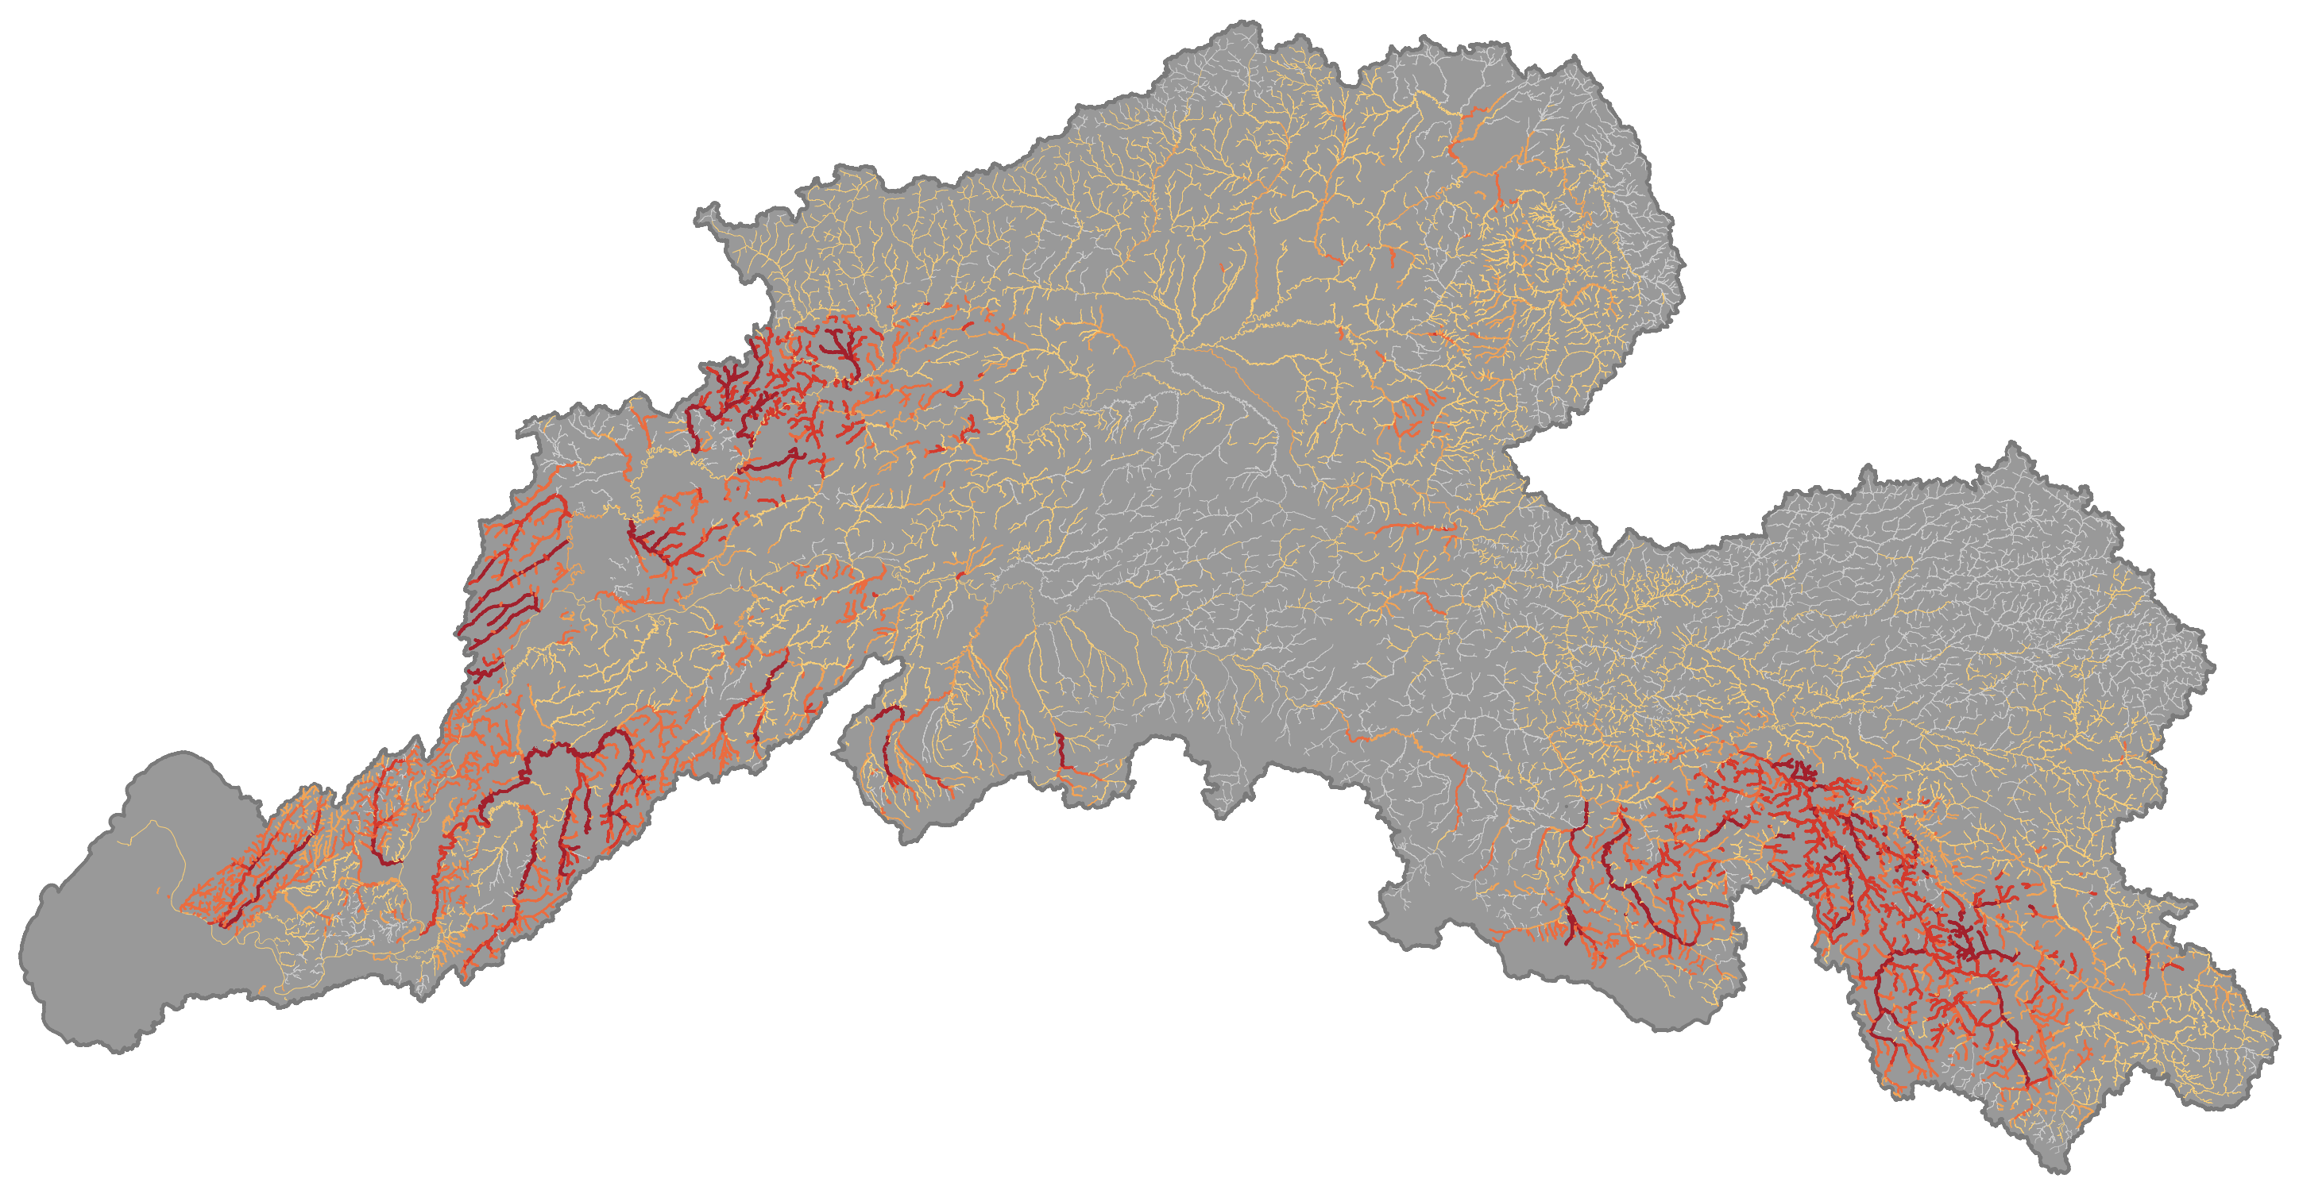
2015 Full run

Slide 3
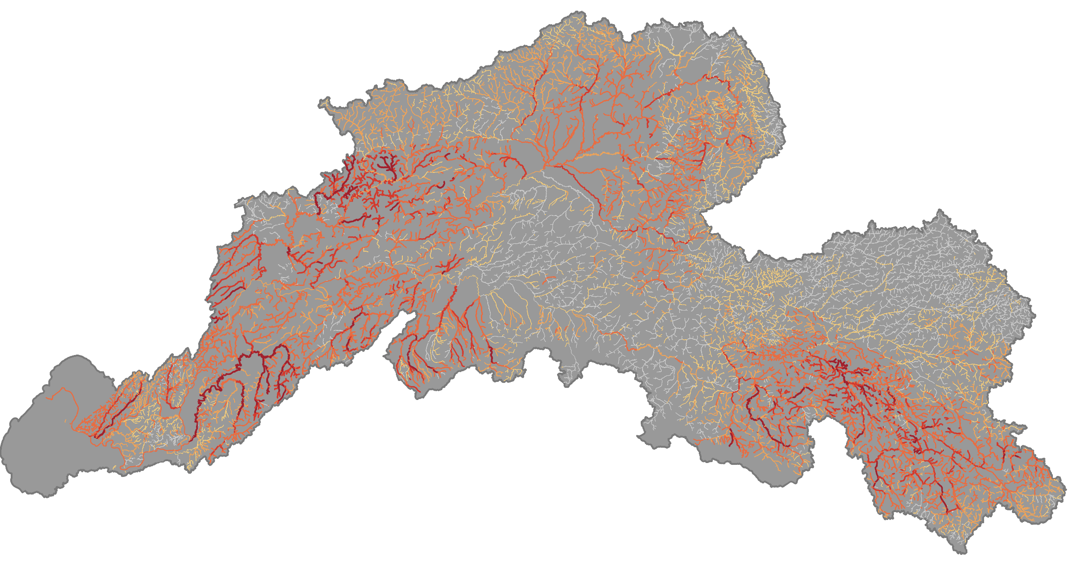
2016 Full run

Slide 4
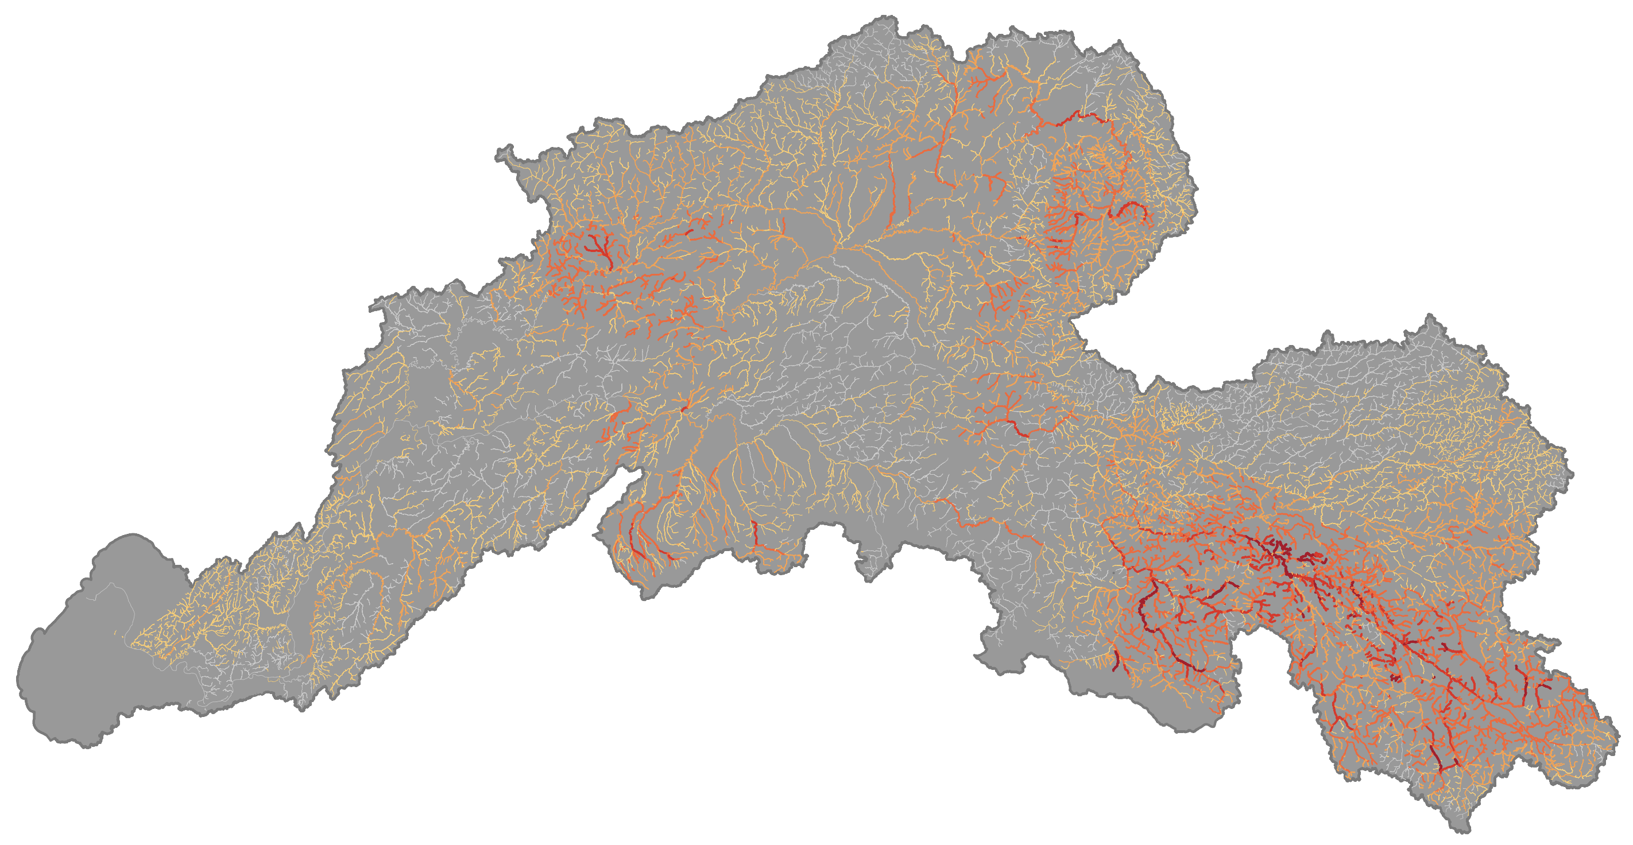
2017 Full run

Slide 5
First half of the run, all years

Slide 6
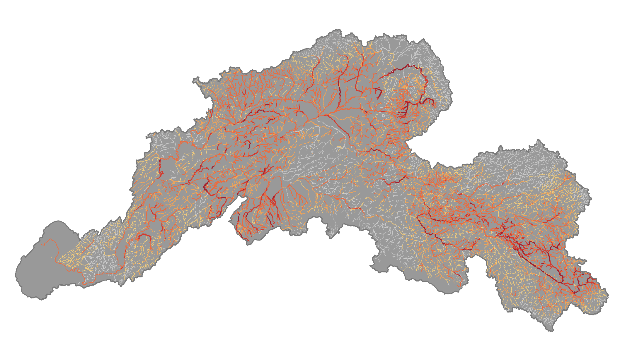
2015

Slide 7
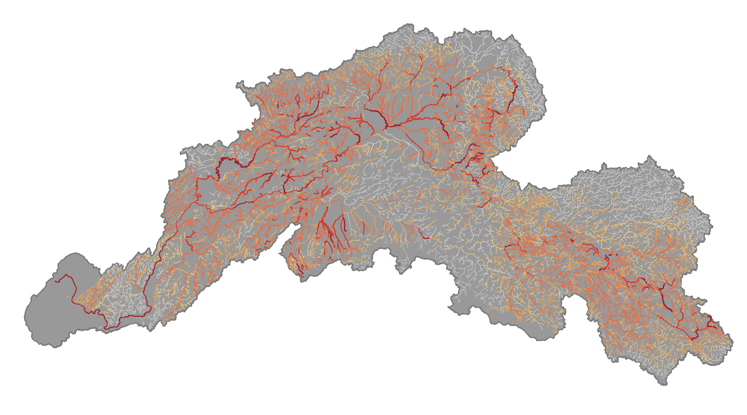
2016

Slide 8
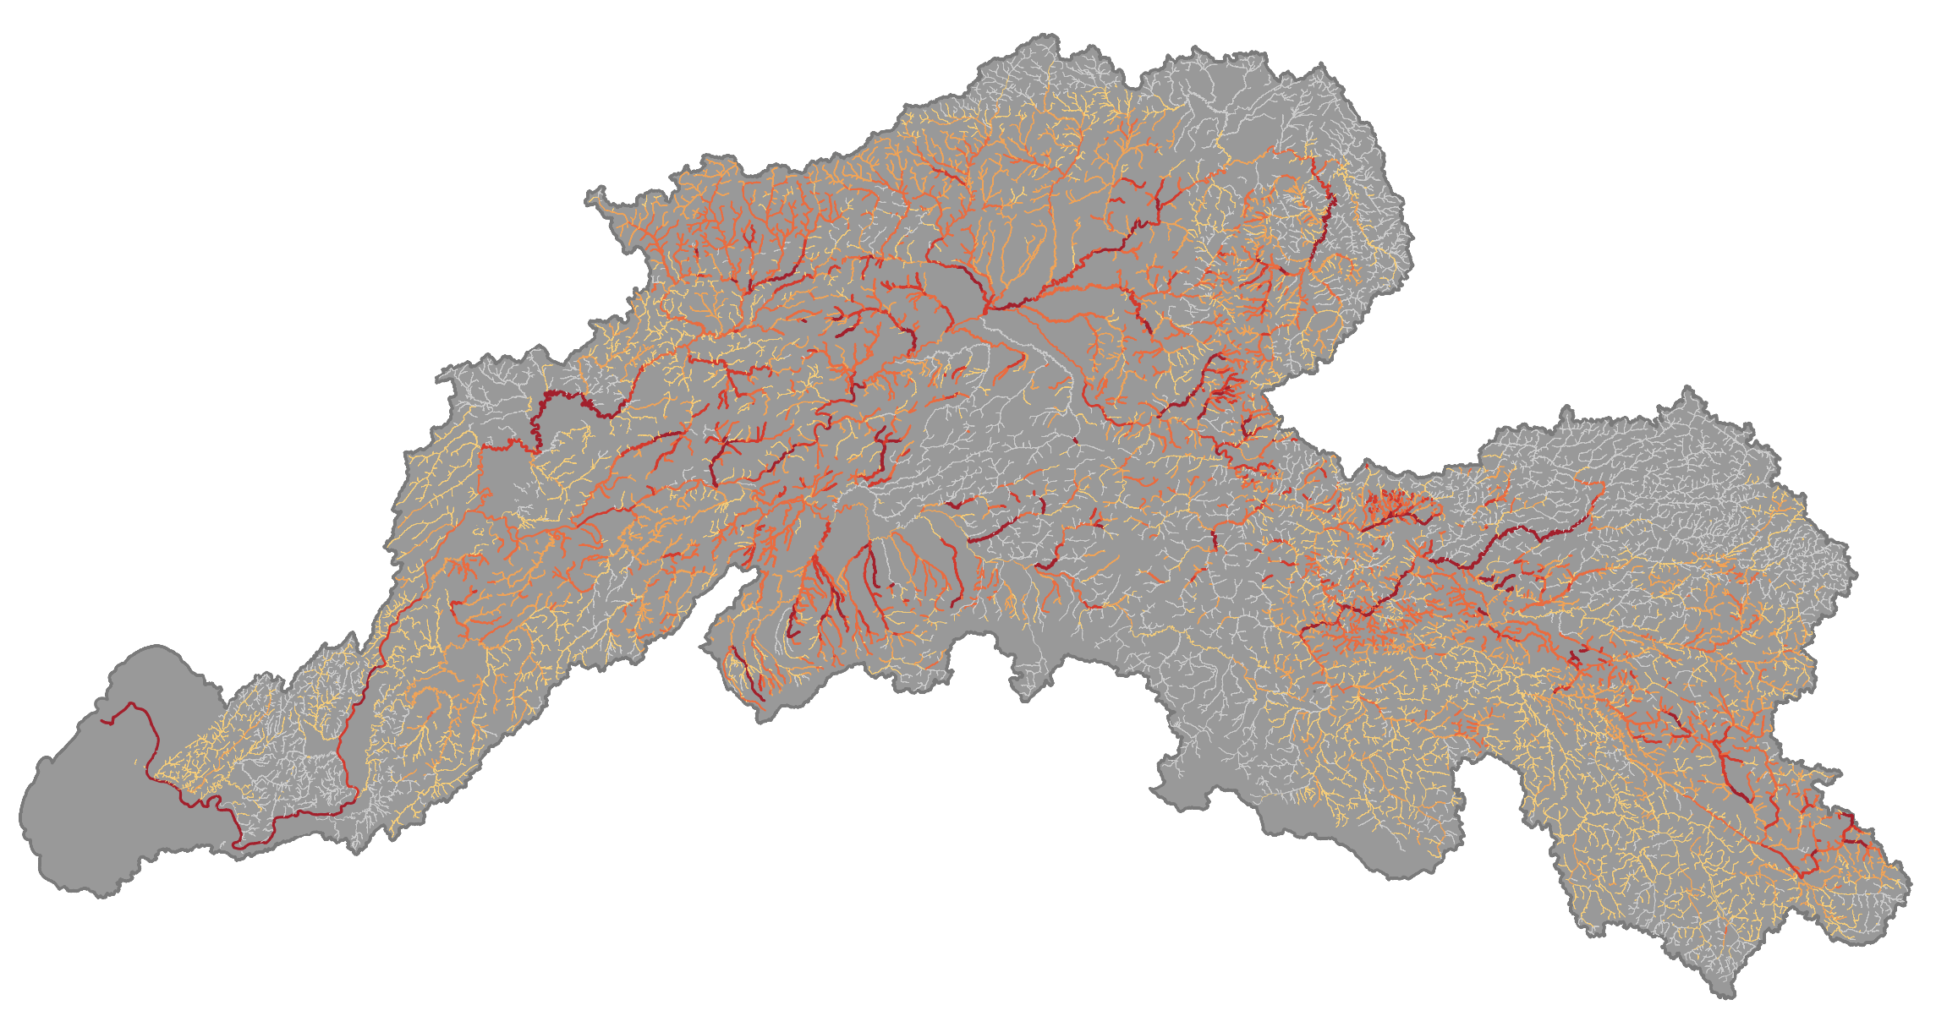
2017

Slide 9
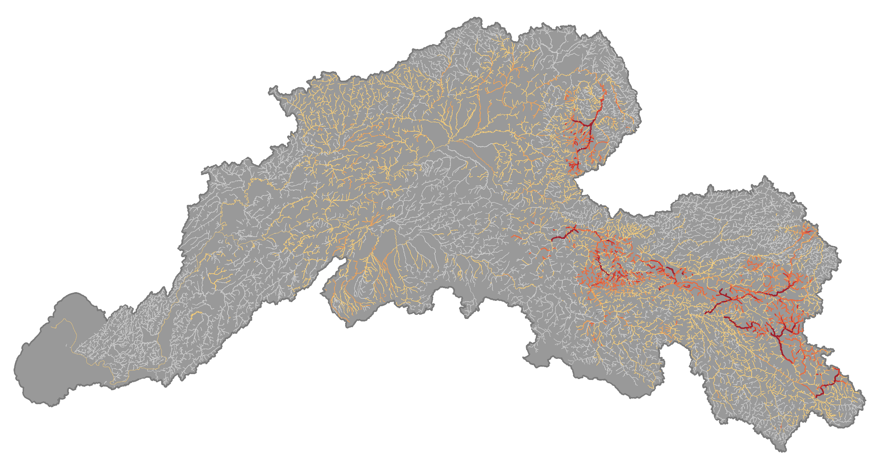
2019

Slide 10
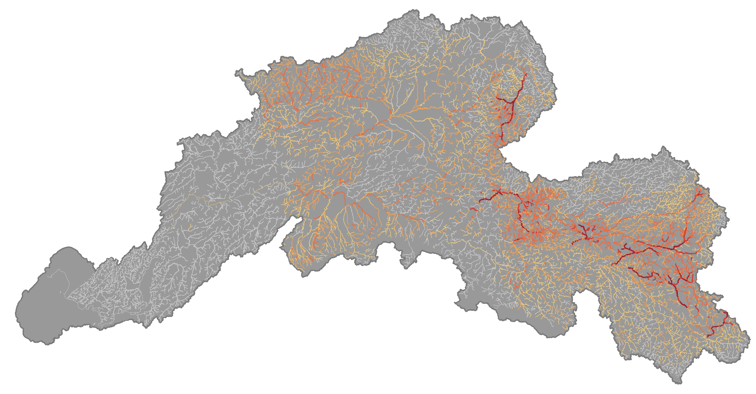
2021

Slide 11
Kuskokwim
Full years all work

